Slide 1
Progress Report
CFD Study on Water Turbine
July 2022
Corporate Technology
American Bureau of Shipping
Spring, Texas, USA

Slide 2
Outline
Designs and conditions
CFD methodology
Study of baseline design
Study of morphed shroud
Study of morphed diffuser
Study of morphed hub
Performance curves and coefficients for the best design
Concluding remarks
Appendix A – The best design with 4-bladed rotor
Appendix B – Drag forces on water turbine

Slide 3
Designs and conditions

Slide 4
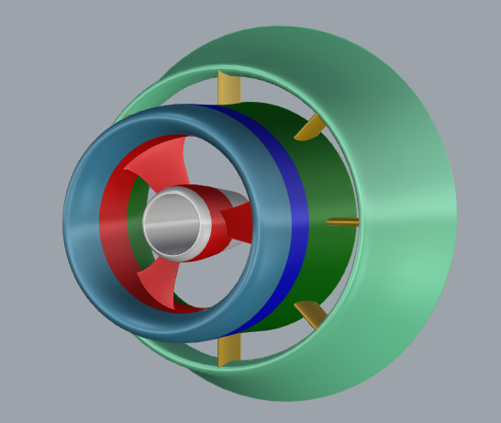
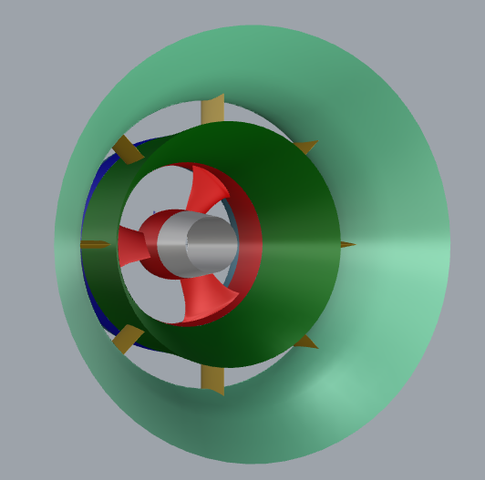
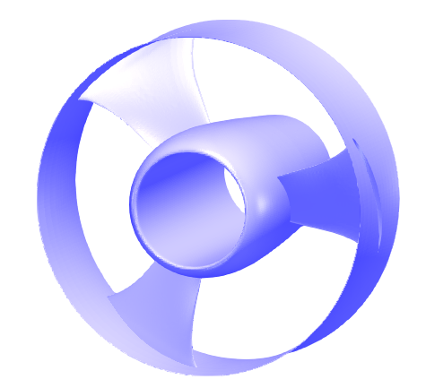
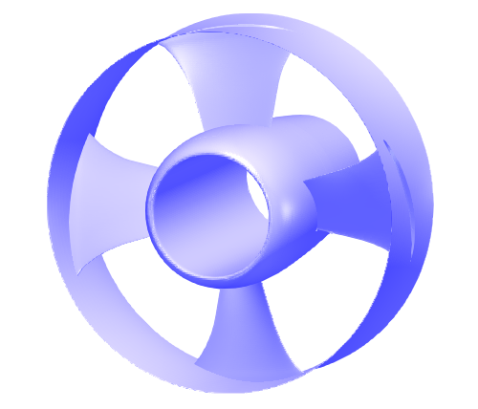
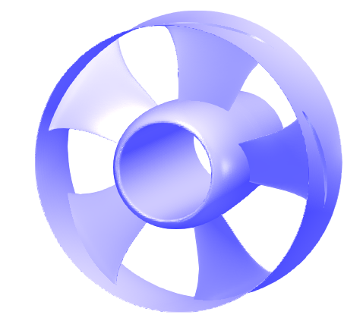
Baseline design (V4.1.8)
Stator
Shroud – morphed for optimum design
Diffuser – morphed for optimum design
Struts – omitted for simplification
Rotor
3, 4, and 5 blades
Hub – morphed for optimum design
Ring
Inflow current speed
1.5 m/s
CFD analysis procedure
3 blades
4 blades
5 blades
Optimum blade number
Optimum shroud
Optimum diffuser
Optimum hub
Best design

Slide 5
CFD Methodology
CFD model, computational domain, and grids

Slide 6
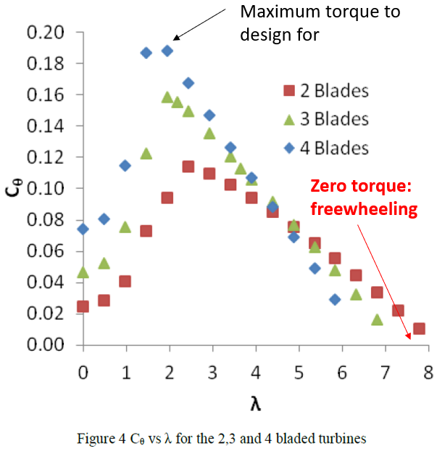
Turbine hydrodynamic efficiency
Common industrial practice: calculate turbine hydrodynamic performance for a series of constant RPMs
Running through different RPMs, one will get a performance curve
Benefits: more robust than running self-started cases with a time-varying RPM
Key points to watch
Maximum torque point to design toward
Freewheeling point for reference (beyond this point, increasing RPM will not provide positive power output)
Reproduced from: C. Morris, A. Mason-Jones, D. M. O'Doherty, and T. O'Doherty, “The influence of solidity on the performance characteristics of a tidal stream turbine,” in Proceedings of the European Wave and Tidal Energy Conference, Nantes, France, September 6–11, 2015.

Slide 7
CFD model details
CFD simulation performed at full scale for all designs
Governing equations: three-dimensional Reynolds-Averaged Navier-Stokes equations
$k−ω$ SST turbulence model
Assuming water turbine fully submerged in water
No free surface considered
No hydrostatic pressure gradient considered
AMI (Arbitrary Mesh Interface) method for rotating grid
CFD Software: OpenFOAM version 2006

Slide 8
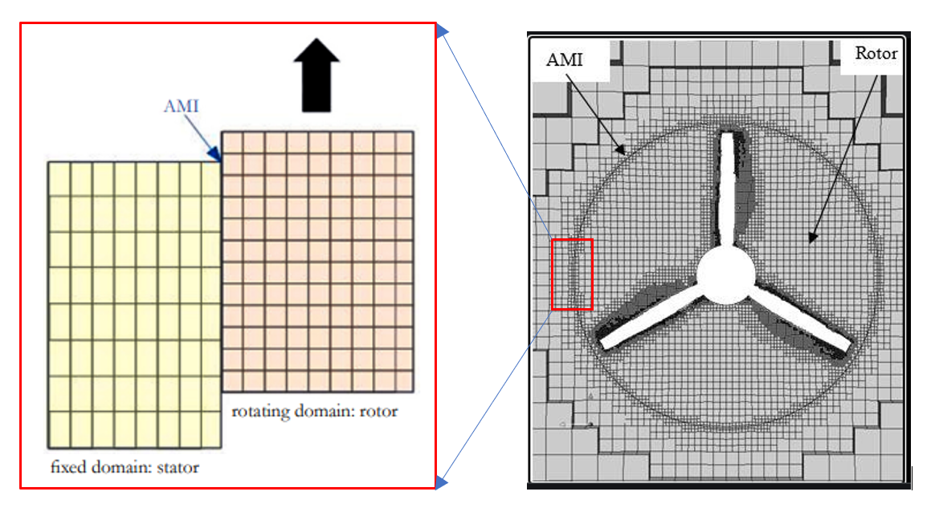
AMI method
AMI (Arbitrary Mesh Interface) is a capability in OpenFOAM which is efficient in pure rotating flow applications, such as turbines and propellers.
AMI can save many grid cells and much computation time because there is no overlapping region for large data interpolation as in overset method.
AMI for rotor and stator grids

Slide 9
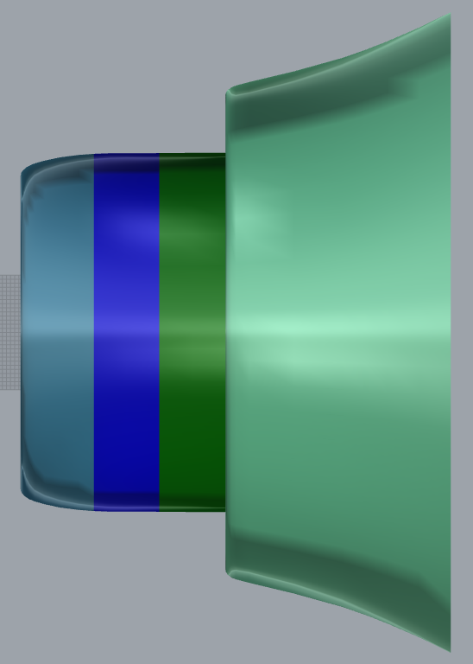
CFD computational domain and boundary conditions
River bank represented by free slip walls
U = 1.5 m/s
Velocity inlet
Pressure outlet
River bank represented by free slip walls

Slide 10
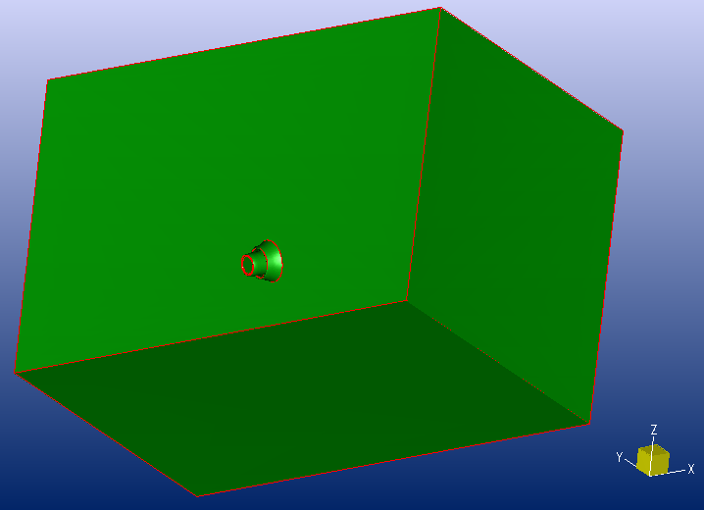
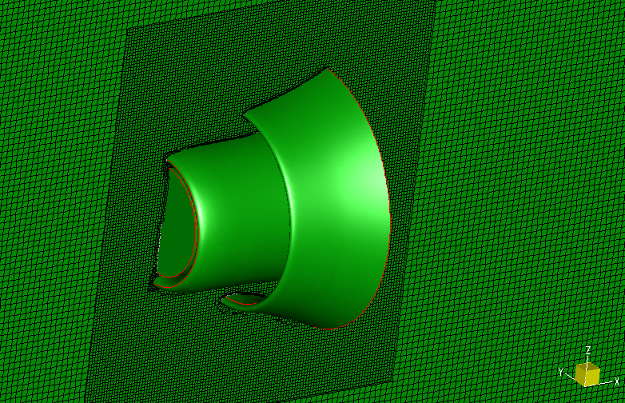
Computational grids – stator
The stator grid leaves a blank cylindrical region to match the rotor grid
The struts were omitted

Slide 11
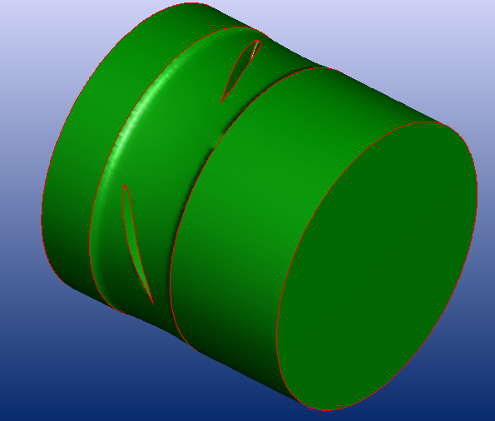
Computational grids – rotor
The baseline design for the rotor with blades of various numbers (3, 4, and 5)
A cylindrical grid domain to enclose the rotor parts (blades, hub, and ring)
3 blades
4 blades
5 blades

Slide 12
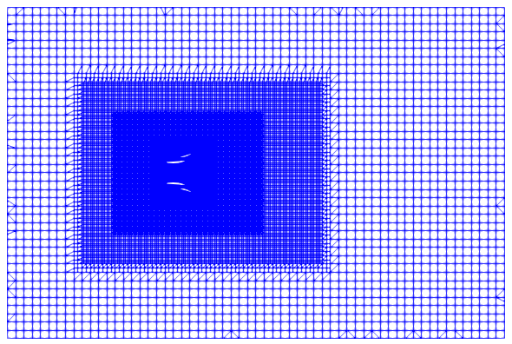
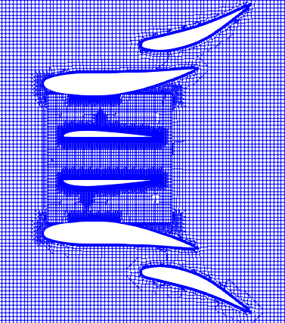
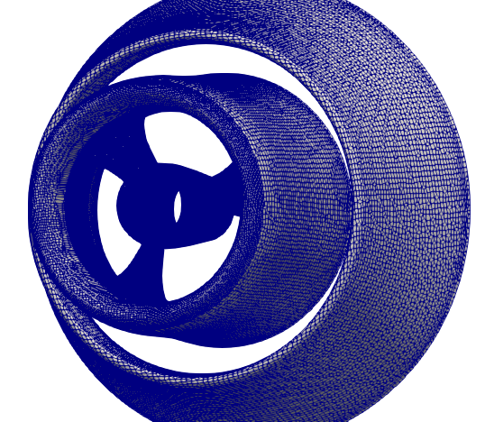
Computational grids – assembled
The stator/rotor grids are assembled as one for CFD analysis
Rotor grid: 2.1 M; Stator grid: 4.2 M. Totally 6.3 M cells (3-bladed)
Independence tests performed for grids and time steps

Slide 13
Study of baseline design

Slide 14
CFD cases and analysis results for baseline design
Baseline design with various blade numbers (3, 4, and 5)
Results of thrust and torque for various RPMs
Dynamic pressure distribution and flow field
Power and torque curves

Slide 15
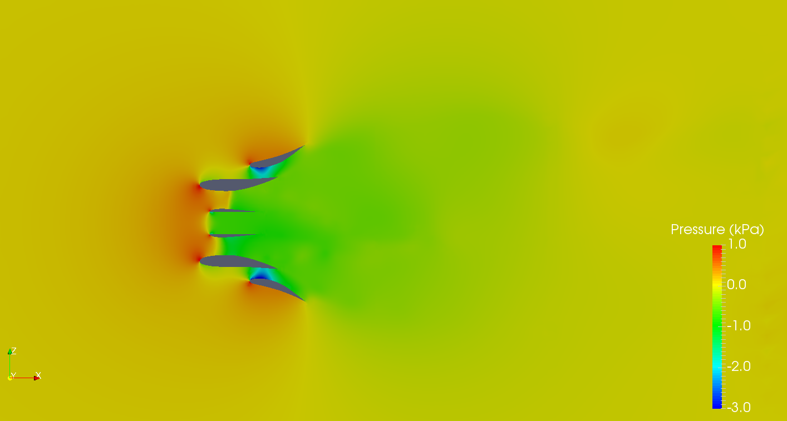
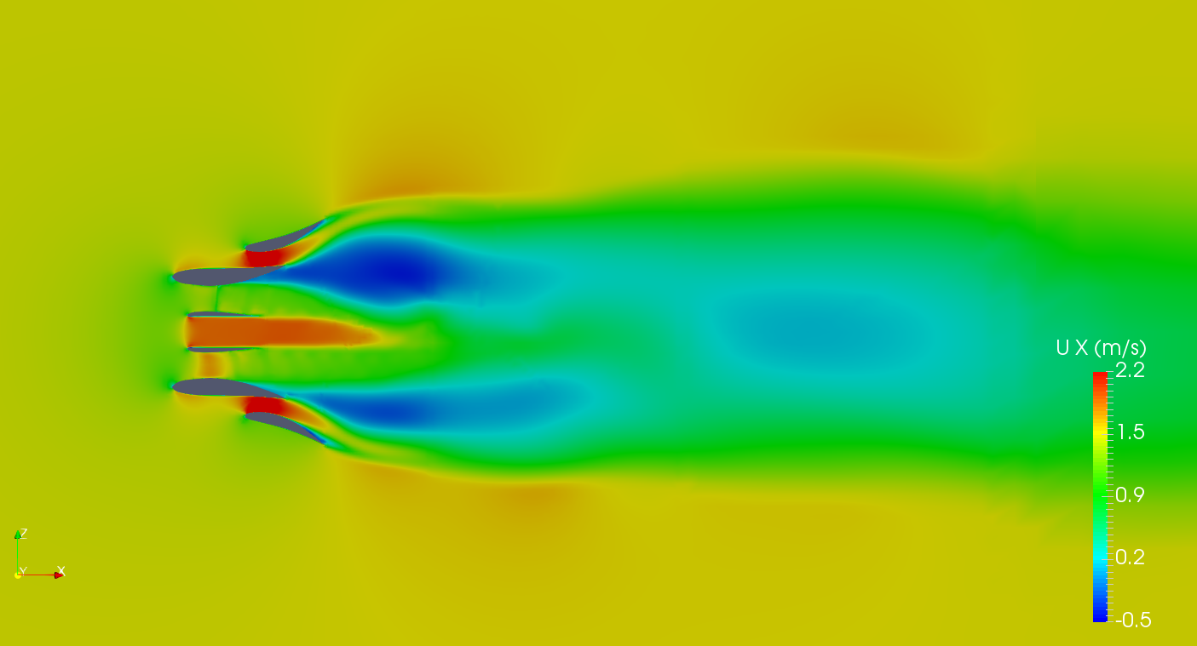
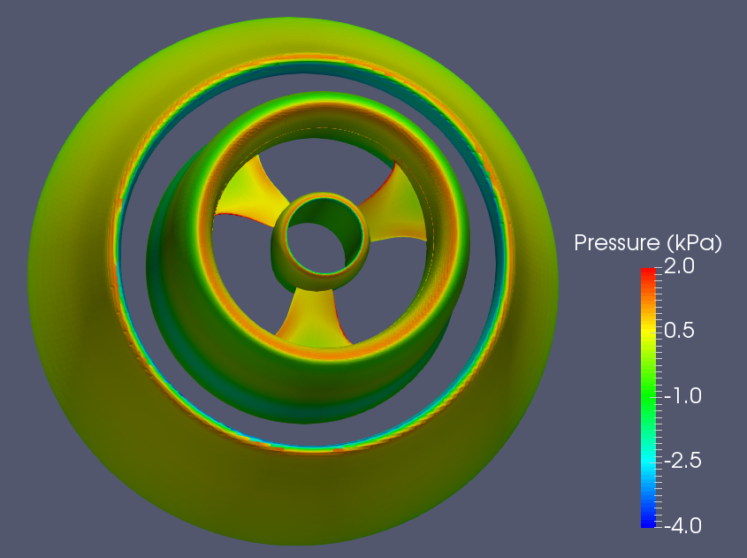
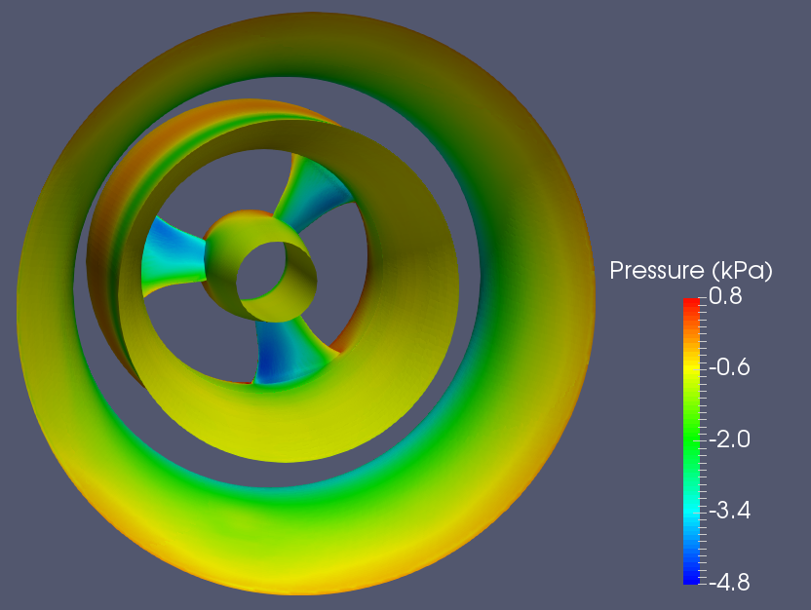
Dynamic pressure and velocity (3 blades, RPM 200)
Dynamic pressure at y = 0
Ux at y = 0
Dynamic pressure on turbine (left: upstream view; right: downstream view)

Slide 16
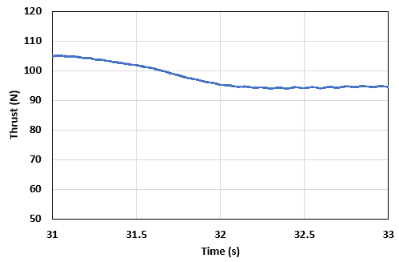
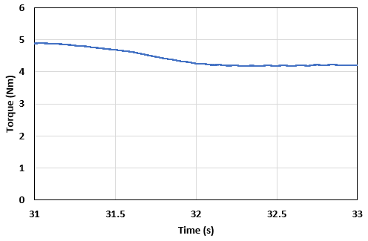
Time histories for thrust and torque
Thrust time history
Torque time history
Note: RPM = 200, 3-bladed design, sum of thrust/toque on blades, hub, and ring.

Slide 17
Summary for baseline design
A CFD study was conducted on the baseline model of water turbine (V4.1.8)
Various blade numbers: 3, 4, and 5
Test condition: inflow current speed of 1.5 m/s
8 RPMs: 50 ~ 400 with interval of 50
The optimum design was determined
Found the best number of blades: 3 for the baseline model
Found the peak RPM: 200 for the maximum power output
Power and torque curves determined
Power and torque coefficients calculated

Slide 18
Study of morphed shroud

Slide 19
CFD cases and analysis results for baseline design
Morphing shroud geometry
Matrix of CFD cases
Computational results and optimum design
Flow field for the optimum design

Slide 20
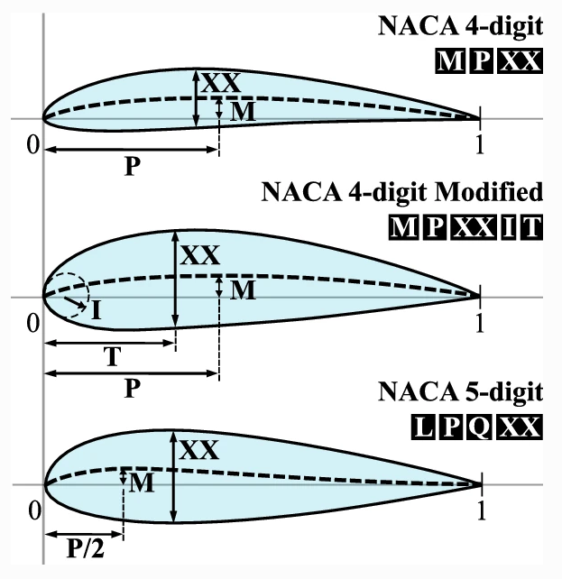
Morphing shroud geometry
Best design from last step – Baseline design with rotor of three blades
Modify the shroud by:
Changing camber (M) by ±10% (3 levels)
Changing thickness (XX) by +10% (2 levels)
Changing max camber location by ±10% (3 levels)
NACA Airfoils

Slide 21
Grid modelling and case set-up
The grid modelling and case set-up are all based on the optimum base-line design with maximum Cp obtained from previous step
The grid modelling for the stator was done by only replacing the shroud geometry
The grid of the rotor (3 blades) was not changed
The boundary / initial conditions are not changed
RPM 200 For $C_{pmax}$

Slide 22
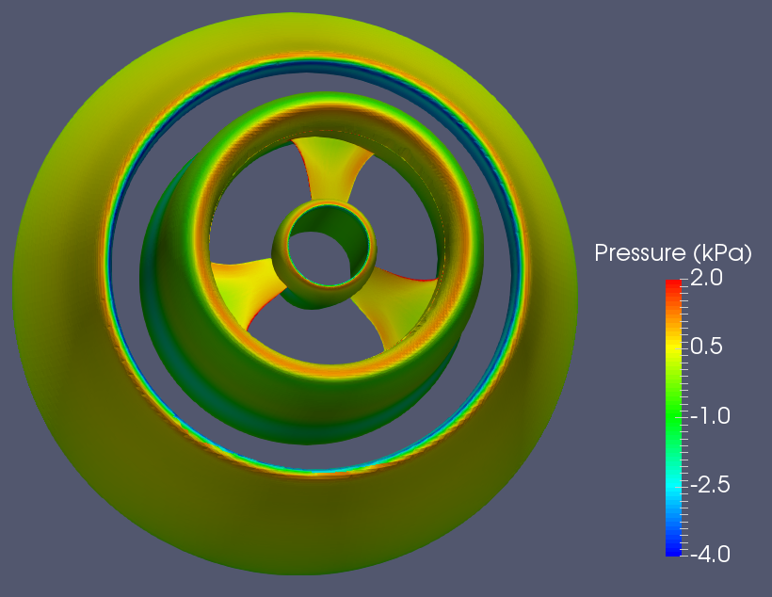
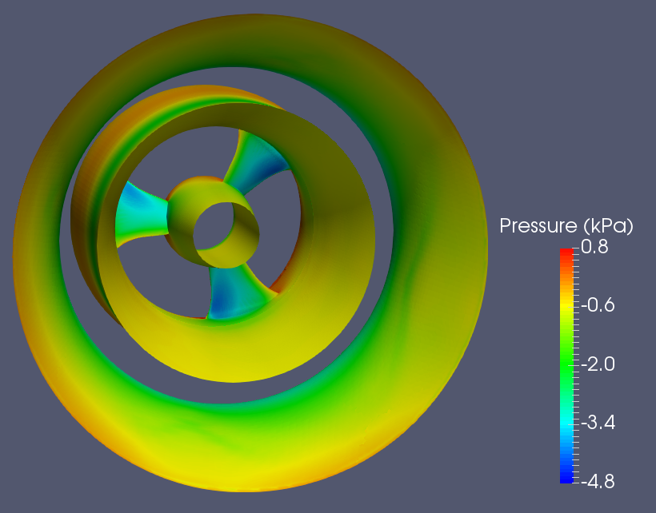
Dynamic pressure on turbine for optimum design
Dynamic pressure on turbine (left: upstream view; right: downstream view)

Slide 23
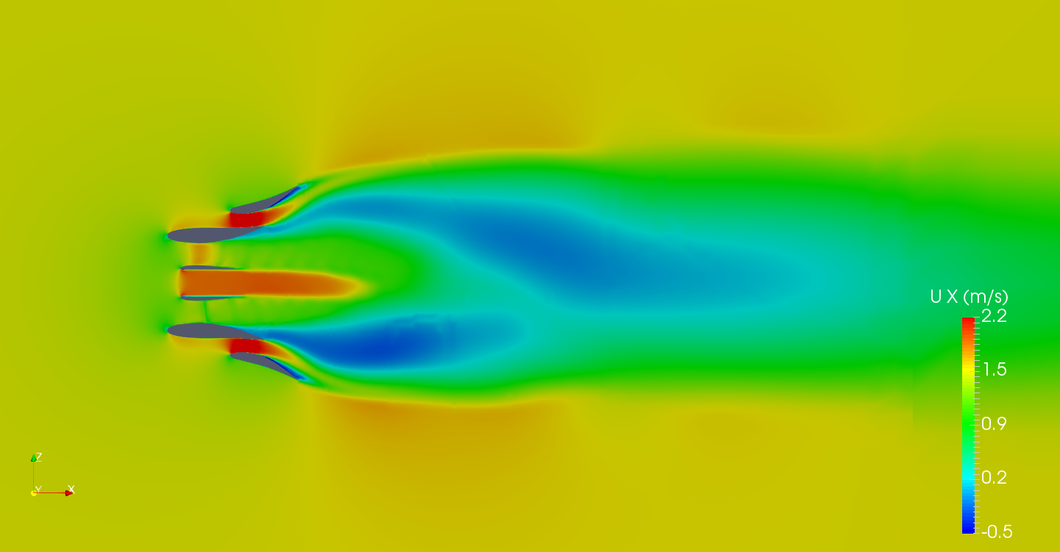
Flow field – velocity Ux for optimum design
Ux at y = 0

Slide 24
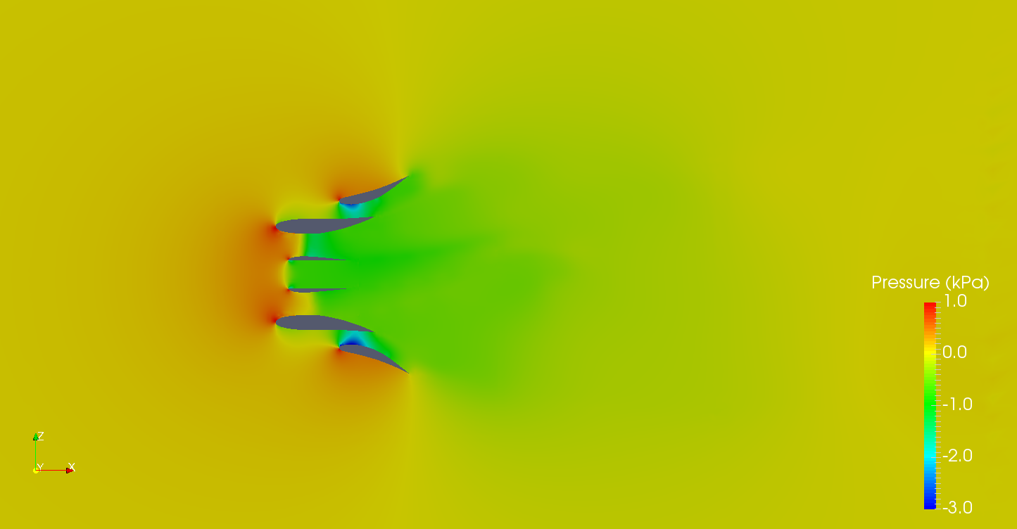
Flow field – dynamic pressure for optimum design
Dynamic pressure at y = 0

Slide 25
Summary for morphed shroud
The geometry of the shroud was morphed with camber, camber location, and thickness.
CFD analysis was performed based on the morphed shroud.
The optimum design was found:
camber max: 0.9
camber location: 1.1
thickness: unchanged
The performance was enhanced by +1.3% for power output.

Slide 26
Study of morphed diffuser

Slide 27
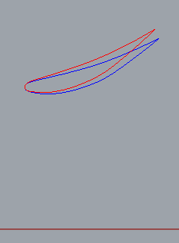
Morphing diffuser geometry
Best design from last step – Baseline design with rotor of three blades and optimum morphed shroud
Modify the diffuser by:
Changing camber (M) by ±10% (3 levels)
Changing thickness (XX) by ±10% (3 levels)
Changing max camber location (P) by ±10% (3 levels)
Changing the diffuser diameter (D) by +10% (2 levels)
Changing the diffuser expansion angle by +4º (2 levels)
NACA Airfoils
+4˚
D/2

Slide 28
Grid modelling and case set-up
The grid modelling and case set-up are all based on the optimum base-line design with maximum Cp obtained from previous step for the morphed shroud
The grid modelling for the stator was done by only replacing the diffuser geometry
The grid of the rotor (3 blades) was not changed
The boundary / initial conditions were not changed
RPM 200 For $C_{pmax}$

Slide 29
Matrix of CFD cases
Four groups (totally 108 cases)
Two expansions: original (E1) and +4º (E2)
Two diameters original (D1) and +10% (D2)
Four groups: E1D1, E1D2, E2D1, and E2D2
Each group is classified with varying thickness, camber max., and camber location.
The averaged torques were recorded.
Based the trends observed, certain cases have been selected for spot check.

Slide 30
Trends observed
Based on the results from group E1D1
If the camber max increased (from 1 to 1.1), the torque output will be decreased.
If the camber thickness increased (from 1 to 1.1), the torque output will be decreased.
The combination of the increased both expansion angle and diffuser diameter (E2D2) can increase the torque output significantly.
For safety and verification of the trends, certain cases have been selected for spot check.

Slide 31
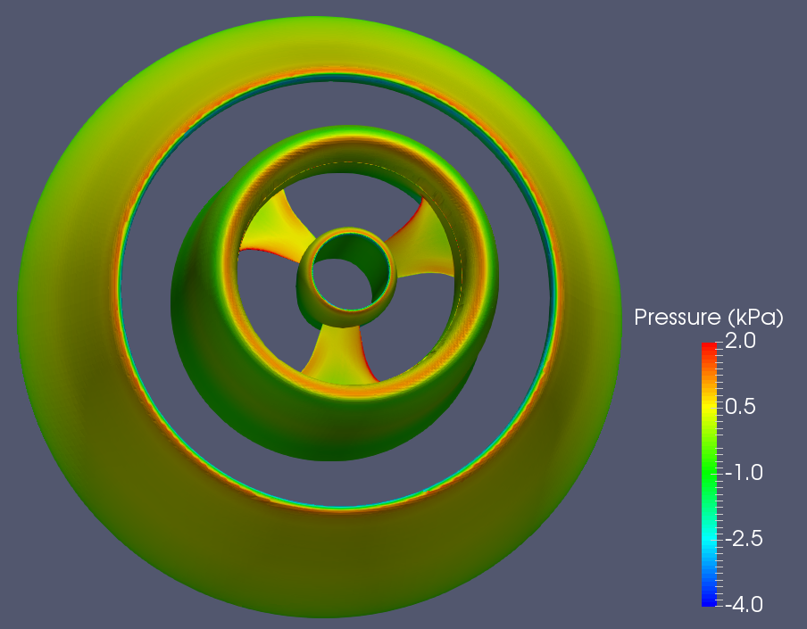
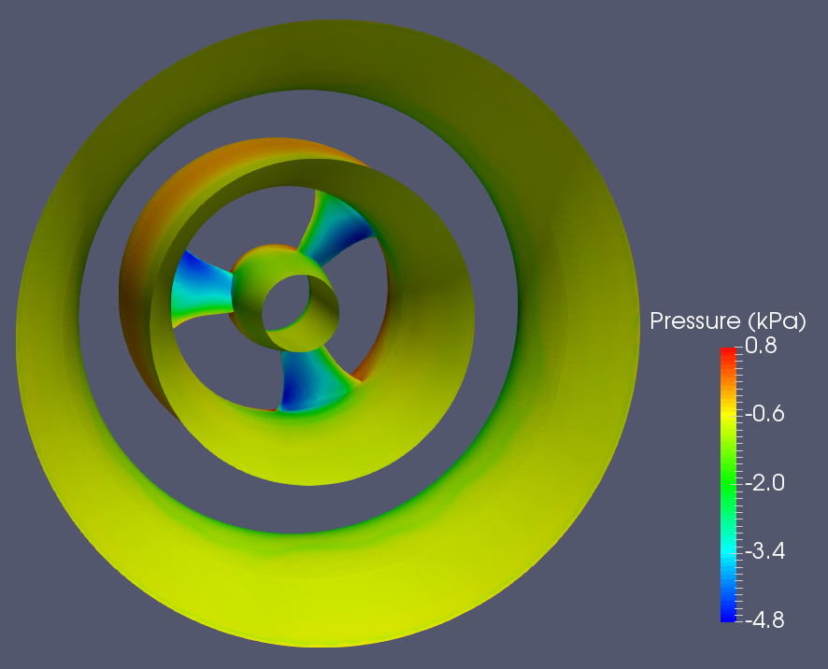
Dynamic pressure on turbine for optimum design
Dynamic pressure on turbine (left: upstream view; right: downstream view)

Slide 32
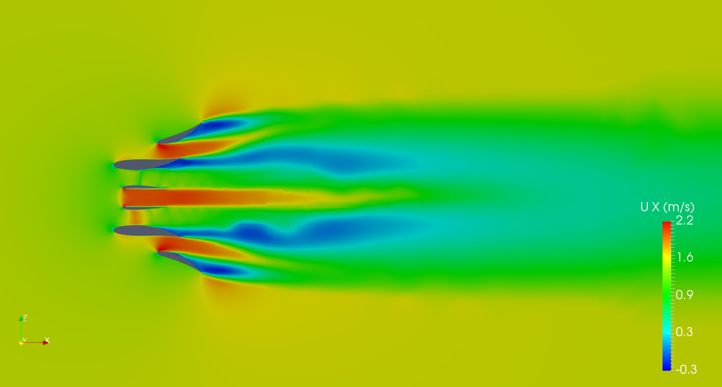
Flow field – velocity Ux for optimum design
Ux at y = 0

Slide 33
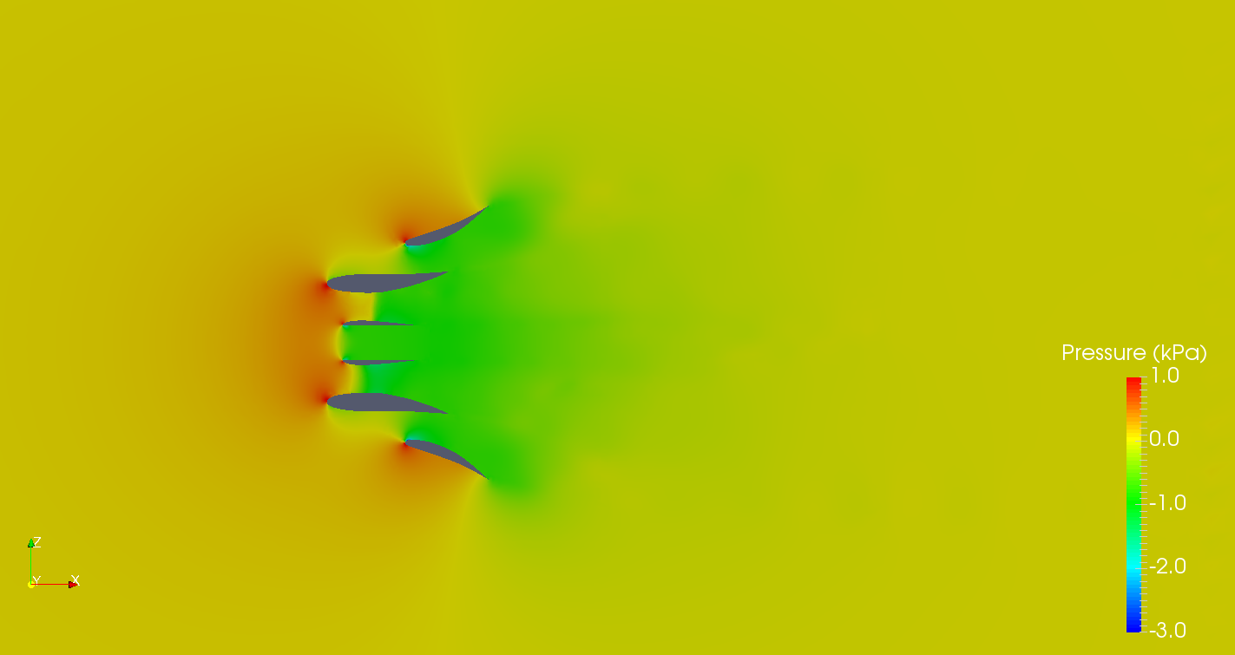
Flow field – dynamic pressure for optimum design
Dynamic pressure at y = 0

Slide 34
Summary for morphed diffuser
The geometry of the diffuser was morphed with expansion angle, diameter, camber, camber location, and thickness.
CFD analysis was performed based on the morphed diffuser.
The optimum design for the morphed diffuser was found:
Expansion: +4°
Diameter: +10%
Thickness: -10%
Camber location: +10%
Camber max.: -10%
The performance was enhanced by +13% for power output.

Slide 35
Study of morphed hub

Slide 36
Morphing hub geometry
Best design from last step – Baseline design with rotor of three blades with optimal morphed diffuser
Modify the shroud by:
Changing camber (M) by ±10% (3 levels)
Changing thickness (XX) by ±10% (3 levels)
NACA Airfoils

Slide 37
Grid modelling and case set-up
The grid modelling and case set-up are all based on the optimum base-line design with maximum Cp obtained from previous step for the morphed diffuser
The grid modelling for the stator was not changed (the optimum design for the diffuser)
The grid of the rotor was replaced with the morphed hub geometry
The boundary / initial conditions were not changed
RPM 200 For $C_{pmax}$

Slide 38
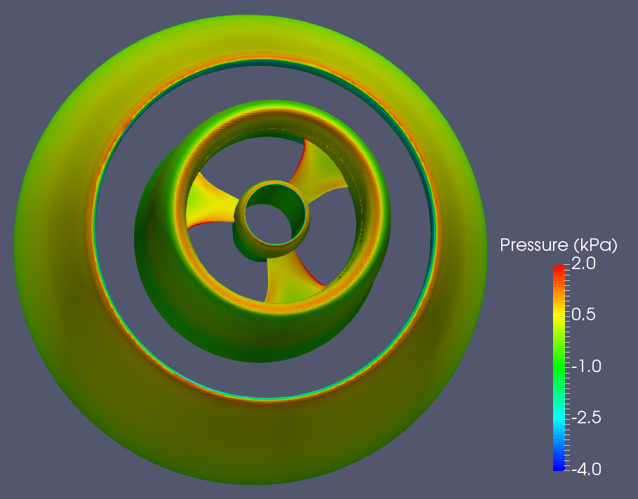
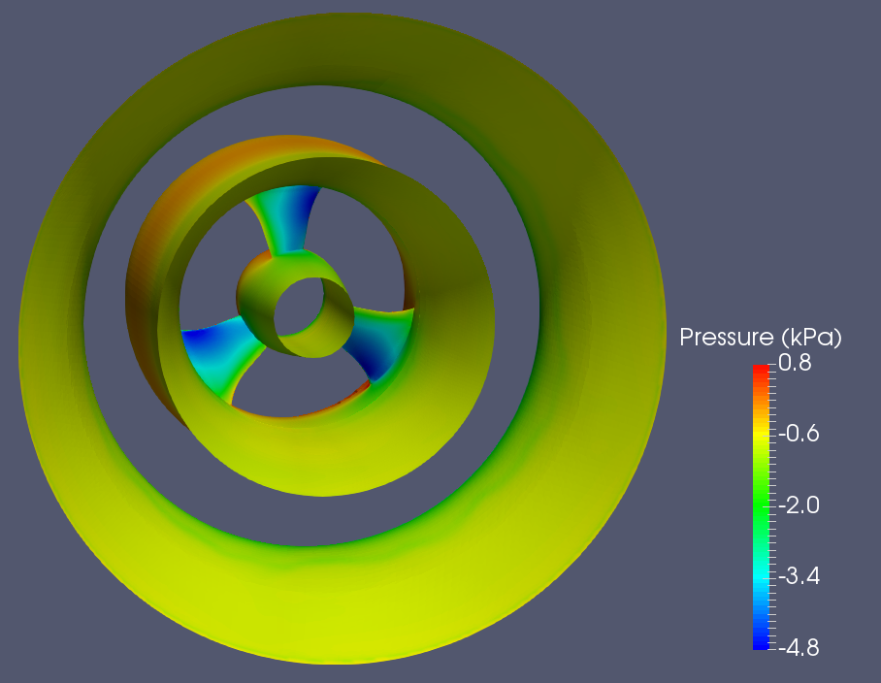
Dynamic pressure on turbine for the best design
Dynamic pressure on turbine (left: upstream view; right: downstream view)

Slide 39
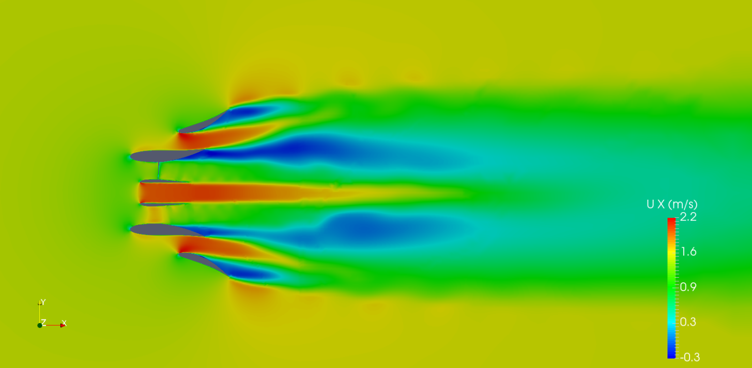
Flow field – velocity Ux for the best design
Ux at z = 0

Slide 40
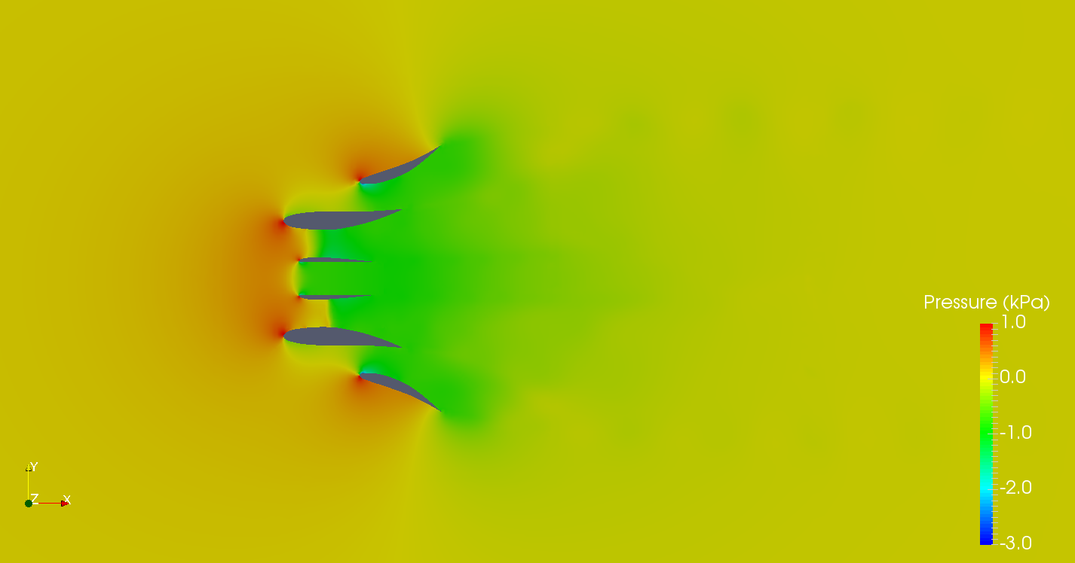
Flow field – dynamic pressure for the best design
Dynamic pressure at z = 0

Slide 41
Movie – Ux for the best design (upstream view)
Ux at y = 0

Slide 42
Movie – Ux for the best design (downstream view)
Ux at y = 0

Slide 43
Movie – dynamic pressure on water turbine
Dynamic pressure on turbine (left: upstream view; right: downstream view)

Slide 44
Summary for morphed hub
The geometry of the hub was morphed with varying camber max and thickness.
CFD analysis was performed based on the morphed hub.
The optimum design for the morphed diffuser was found:
Thickness: -10%
Camber max.: -10%
The performance was enhanced by +15% for power output.
It is also the best design for the water turbine followed by analyzing morphed shroud and morphed diffuser based on the baseline design.

Slide 45
Performance curves and coefficients for the best design

Slide 46
Concluding Remarks

Slide 47
Concluding remarks
CFD analysis has been performed on the water turbine for various designs.
Three blades were found as the optimum blade number for the baseline design.
Limited improving effect of morphing shroud and hub (~ +2%)
The combination of the increased both expansion angle and diffuser diameter has significant effect in improving the water turbine performance (~ +15%).
The final power and torque curves have been plotted, and the power and torque coefficients have been calculated.
The best design has been determined through the systematic CFD analysis.
Optimum for diffuser:
Expansion: +4°
Diameter: +10%
Thickness: -10%
Camber location: +10%
Camber max.: -10%
Best Design
Optimum for shroud:
Camber max: -10%;
Camber location: +10%; Thickness: unchanged.
Optimum for baseline:
3 blades
Optimum for hub:
Thickness: -10%
Camber max.: -10%

Slide 48
Appendix A
The best design with 4-bladed rotor

Slide 49
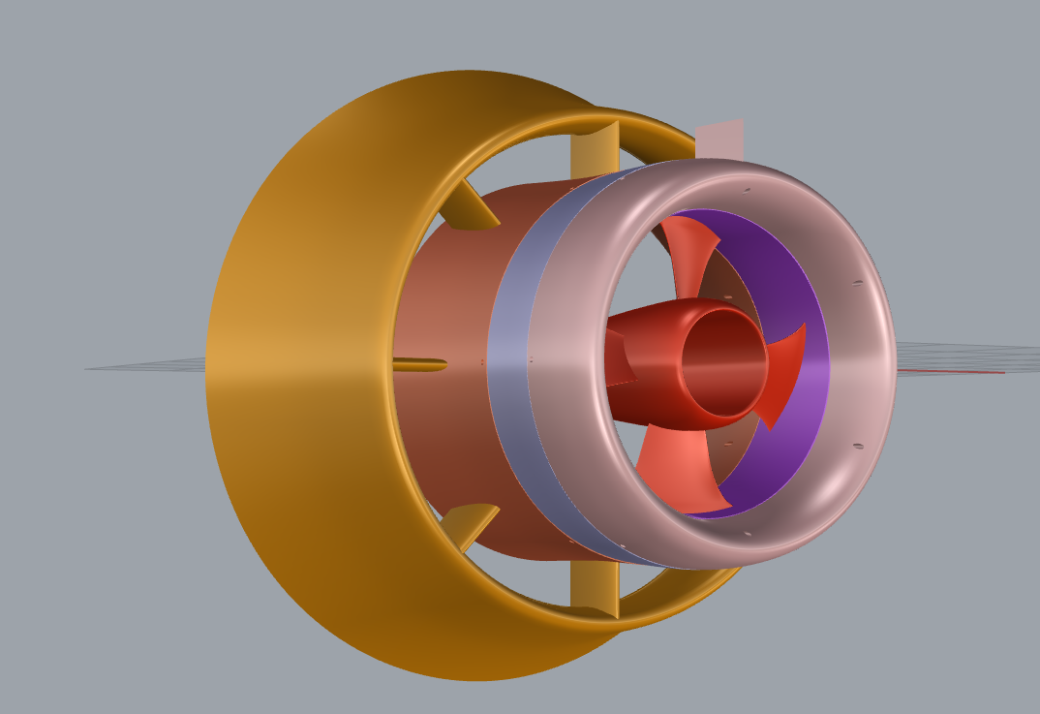
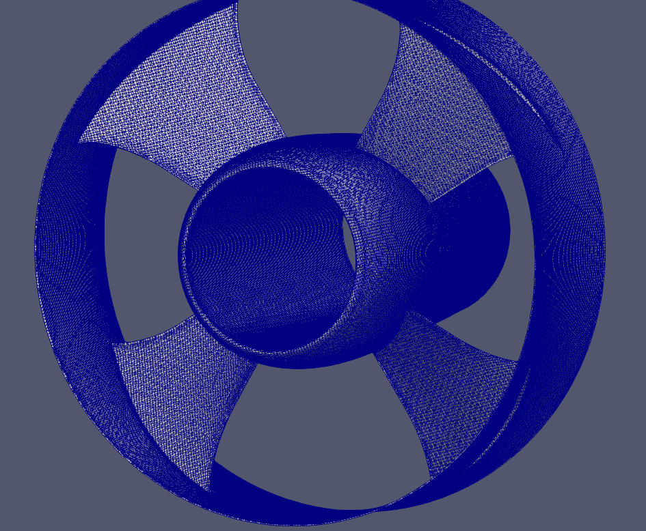
Grid modelling and case set-up for 4-bladed rotor
The grid modelling and case set-up are all based on the best design obtained from the present study.
The grid modelling for the rotor was done by only replacing the 4-bladed rotor geometry
The grid of the stator was not changed
The boundary/initial conditions were not changed
Three RPMs (150, 200, and 250) for targeting max power output
4-bladed design
Surface mesh for 4-bladed rotor

Slide 50
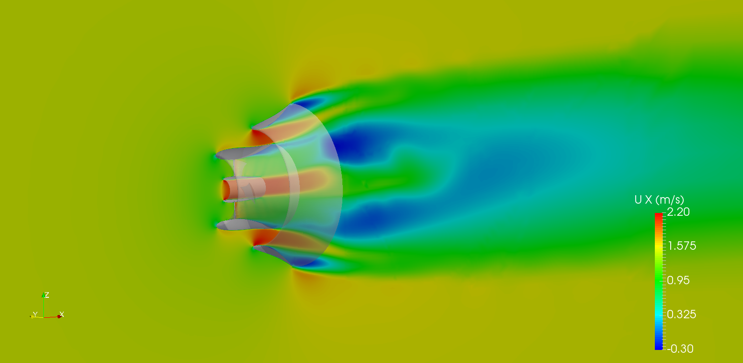
Flow field – velocity Ux for the 4-bladed design
Ux at y = 0 (upstream view)

Slide 51
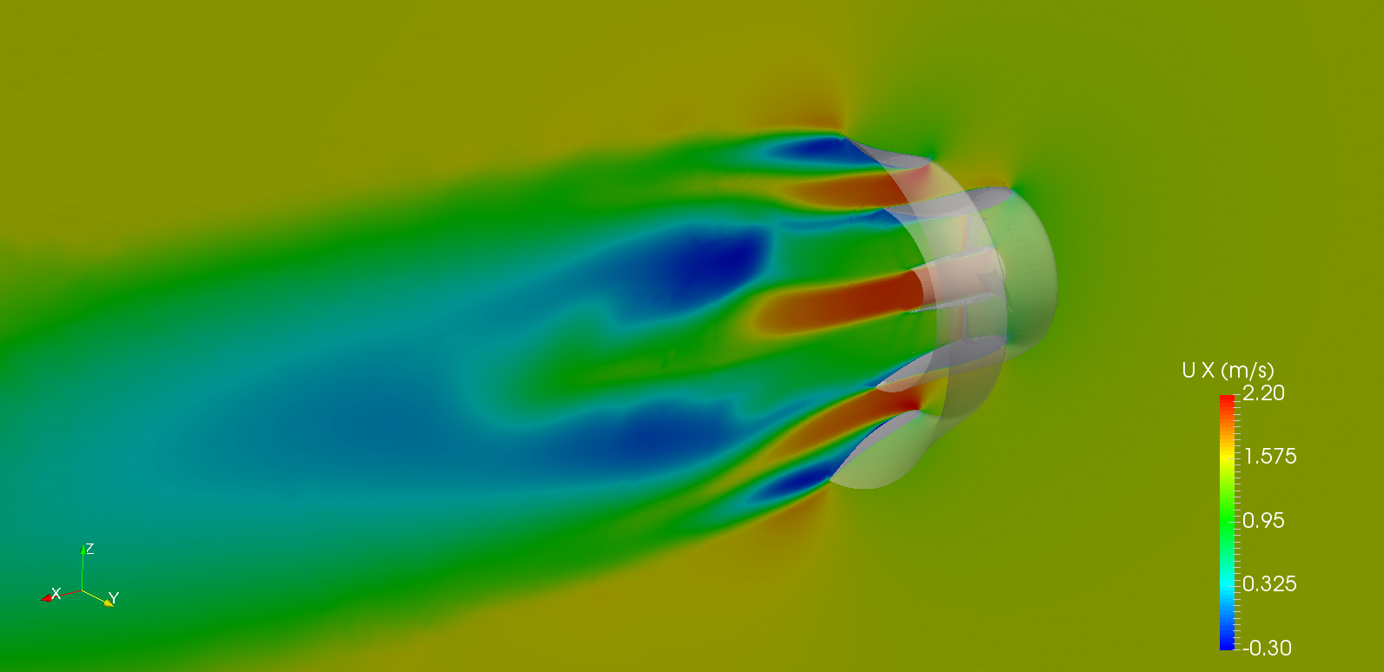
Flow field – velocity Ux for the 4-bladed design
Ux at y = 0 (downstream view)

Slide 52
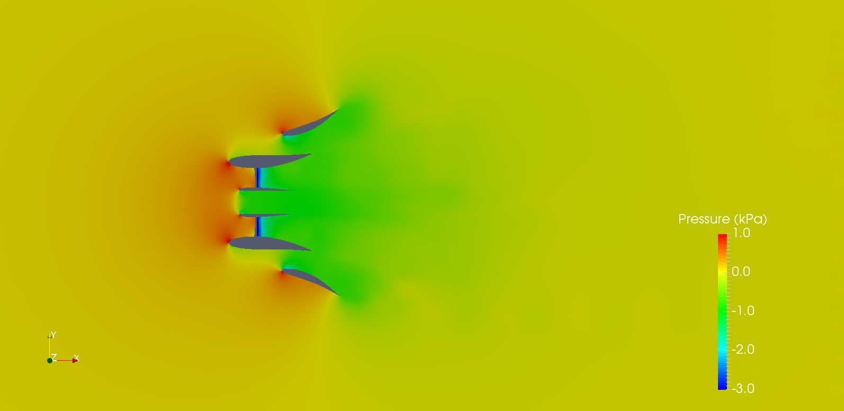
Flow field – dynamic pressure for the 4-bladed design
Dynamic pressure at z = 0

Slide 53
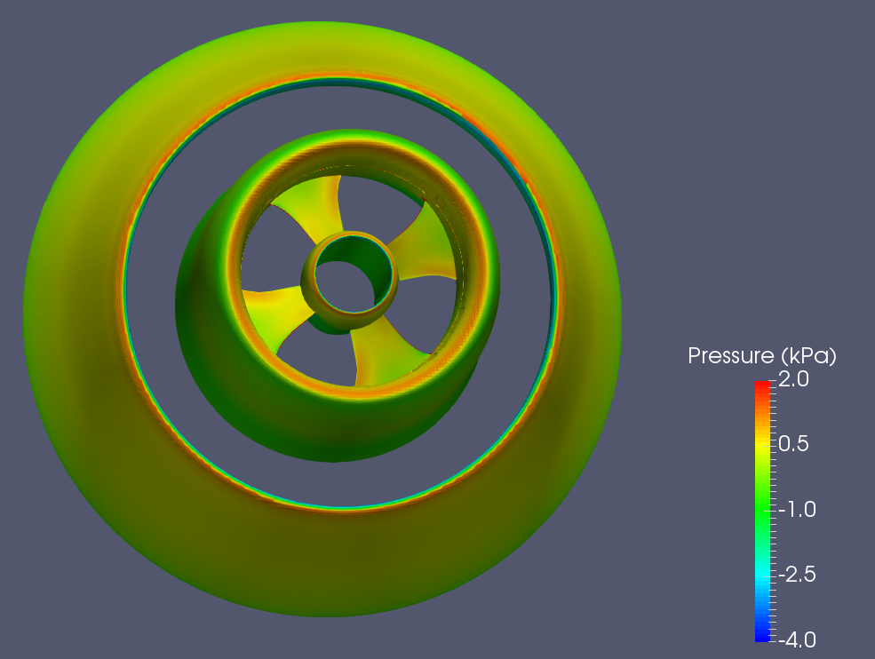
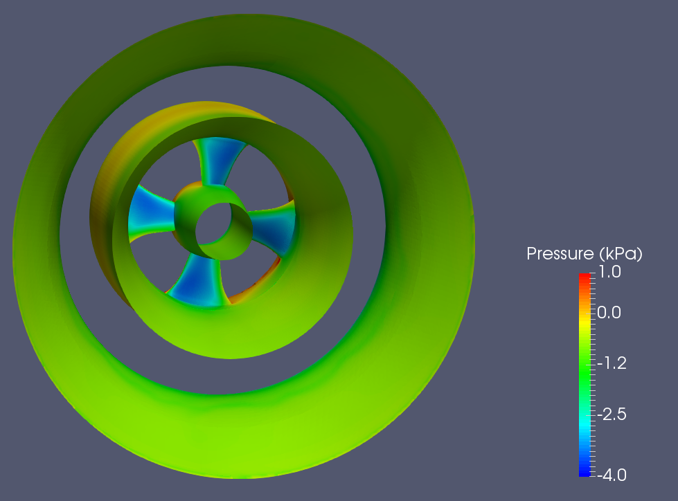
Dynamic pressure on turbine for the 4-bladed design
Dynamic pressure on turbine (left: upstream view; right: downstream view)

Slide 54
Appendix B
Drag forces on water turbine

Slide 55
Two scenarios for various inflow speeds
Scenario 1:
Inflow speed = 1.5 m/s
Based on the best design case to output drag forces
Scenario 2:
Inflow speed = 2.5 m/s
Also based on the best design case, but the rotor and stator grids are refined, and the time step is reduced accordingly due to the increased inflow speed.
For both scenarios:
RPM = 200
Same boundary/initial conditions applied
Decomposed drag components are outputted, analyzed and compared.
Drag coefficients (C_{D}) were calculated for decomposed drag components and total drag force.
Drag coefficient:
$$C_{D}=\frac{F_{D}}{\frac{1}{2}ρAV^{2}}$$

Slide 56
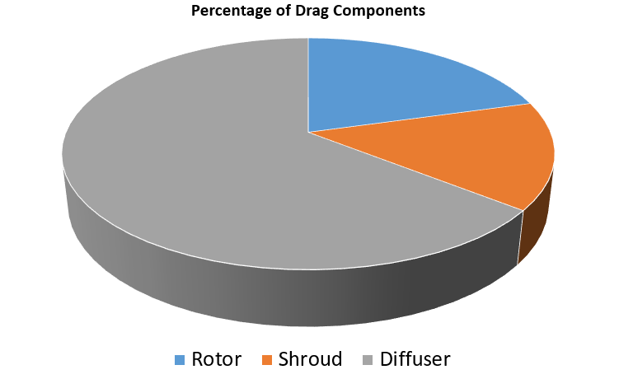
Drag forces and coefficients for 1.5 m/s inflow speed
Drag_{Total} = Drag_{Rotor} + Drag_{Stator}
$$C_{D}=\frac{F_{D}}{\frac{1}{2}ρAV^{2}}$$
Drag coefficient:
$$A=πR^{2}$$
R: Blade radius
Drag_{Stator} = Drag_{Shroud} + Drag_{Diffuser}
Component | Drag (N) | C_{D} | Percentage
Rotor | 101.25 | 1.08 | 20.6%
Stator | 389.3 | 4.17 | 79.4%
Shroud | 73.61 | 0.79 | 15.0%
Diffuser | 315.69 | 3.38 | 64.4%
Total | 490.55 | 5.25 | 100%
20.6%
15.0%
64.4%
Water turbine: Rotor + Stator
Stator: Shroud + Diffuser

Slide 57
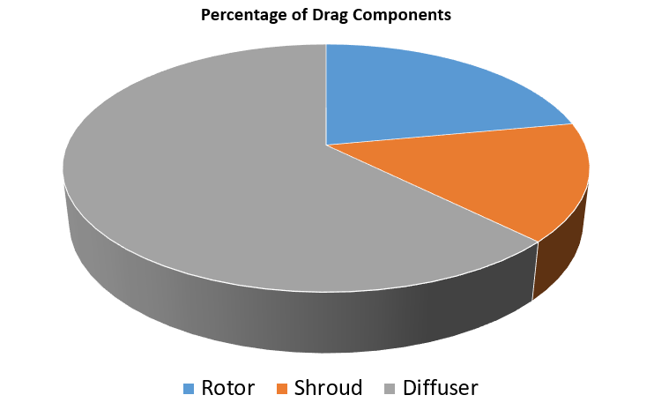
Drag forces and coefficients for 2.5 m/s inflow speed
Drag_{Total} = Drag_{Rotor} + Drag_{Stator}
$$C_{D}=\frac{F_{D}}{\frac{1}{2}ρAV^{2}}$$
Drag coefficient:
$$A=πR^{2}$$
R: Blade radius
Drag_{Stator} = Drag_{Shroud} + Drag_{Diffuser}
Component | Drag (N) | C_{D} | Percentage
Rotor | 309.39 | 1.19 | 22.1%
Stator | 1093.64 | 4.21 | 77.9%
Shroud | 215.51 | 0.83 | 15.3%
Diffuser | 878.13 | 3.38 | 62.6%
Total | 1403.07 | 5.40 | 100%
22.1%
15.3%
62.6%
Water turbine: Rotor + Stator
Stator: Shroud + Diffuser

Slide 58
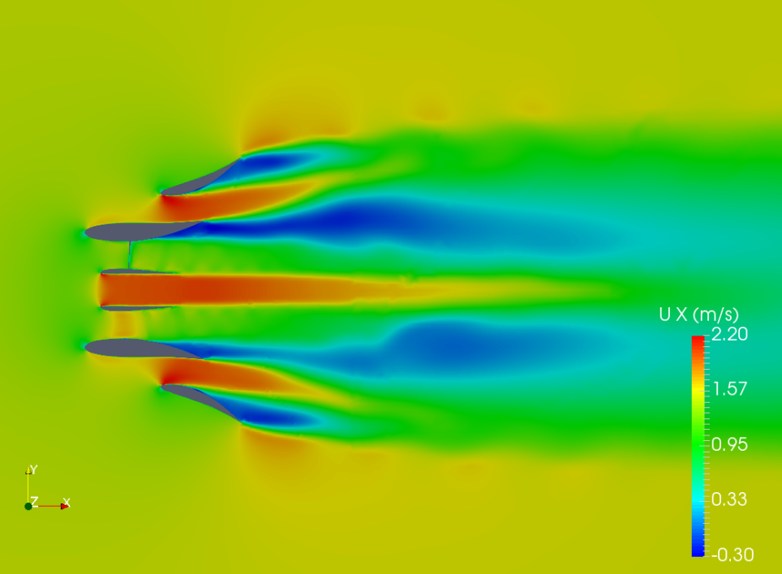
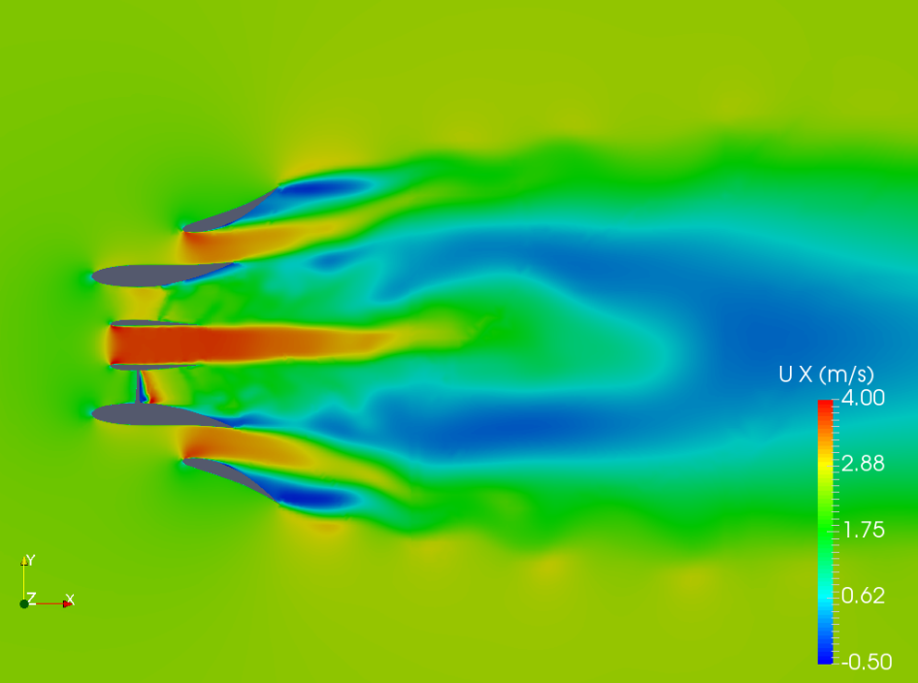
Flow field – Ux
Inflow: 1.5 m/s
Inflow: 2.5 m/s
Ux at z = 0

Slide 59
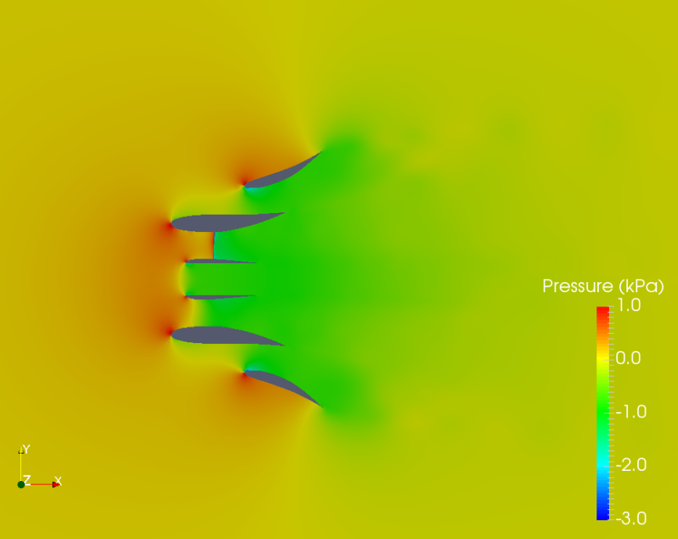
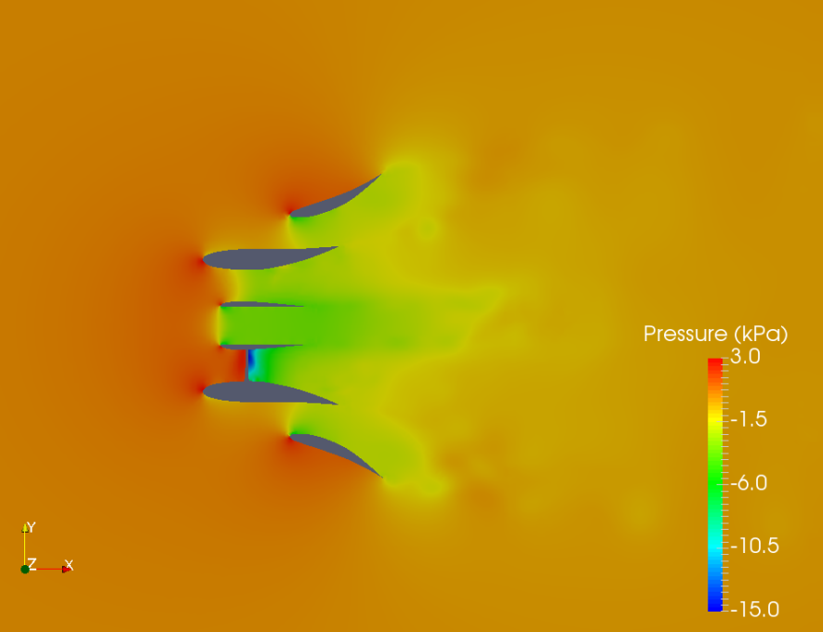
Flow field – dynamic pressure
Inflow: 1.5 m/s
Inflow: 2.5 m/s
Dynamic pressure at z = 0

